Slide 1
Lab 1

Slide 2
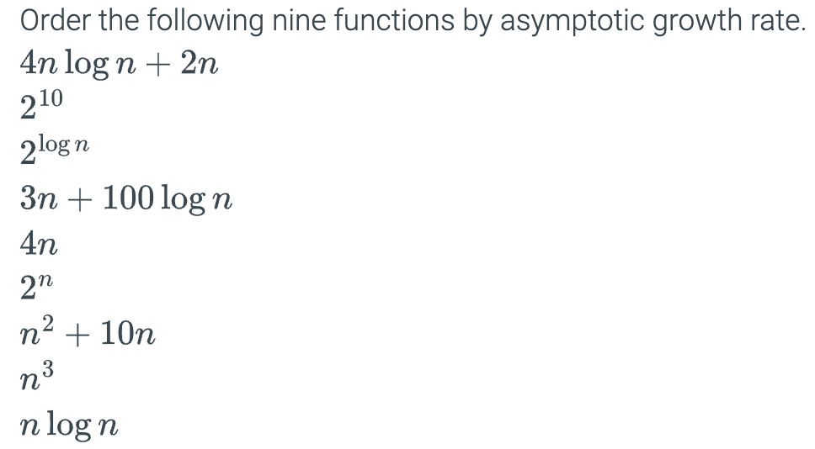
1.

Slide 3
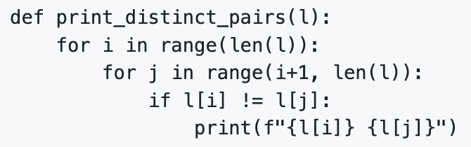
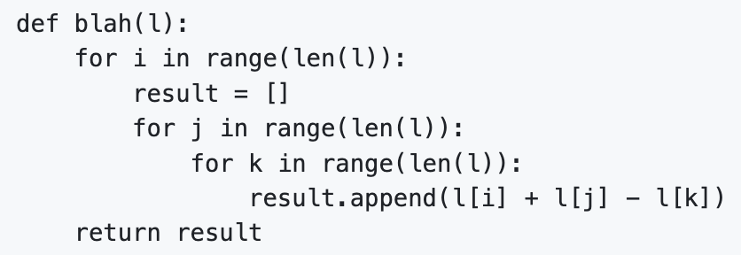
2. Write a python function that has O(n^3) time complexity and O(n) space complexity.
3. Find out the time and space complexity for the following two functions:

Slide 4
Submission Instructions
Submit the following in iCollege:
Your responses to Question #1~#3 (YOUR_FULL_NAME_Lab1.docx/.txt)
Due date/time: Same Day within the lab period (strongly recommended)
Late submission (10% late submission penalty – waived for Lab1!) :
Same Day - after the lab period but before 11:59PM
Be prepared to answer a couple of questions on your responses.

